Slide 1
Shakespeare
His life and times

Slide 2
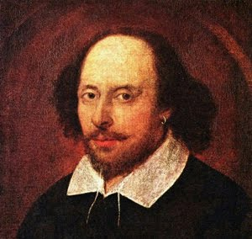
William Shakespeare

Slide 3
General Facts
Born in 1564 in Stratford Upon Avon
Father was a middle class landowner
Probably went to school
Thought to have apprenticed as a butcher or a shoemaker
Married Anne Hathaway at 18 (she was 22)
Had 3 children
Son died in infancy

Slide 4
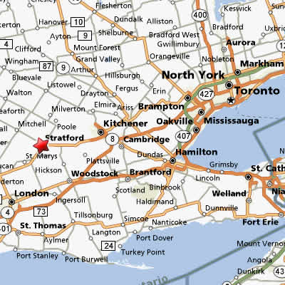
Map of England

Slide 5
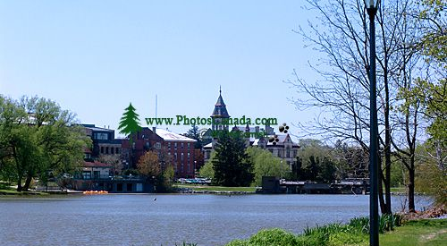
Stratford Upon Avon

Slide 6
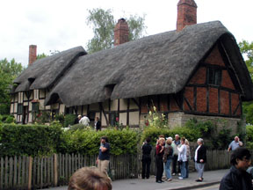
Anne Hathaway’s Cottage

Slide 7
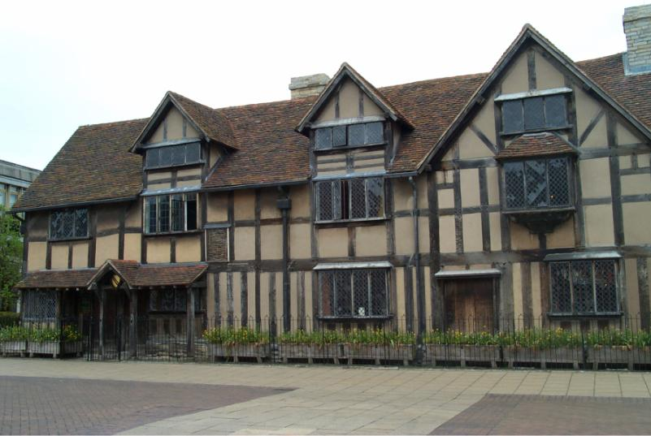
House where Shakepeare lived as a child

Slide 8
Left his wife to become a travelling player after 2 years of marriage
Eventually went to London
Returned to Stratford in his middle age (after his father died and his daughter is excommunicated)
Dies in 1616 – leaves his second best bed to his wife

Slide 9
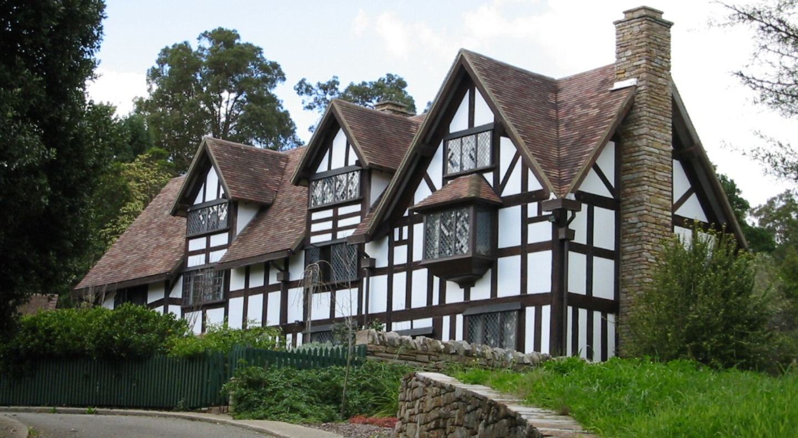
Shakespeare’s home in town

Slide 10
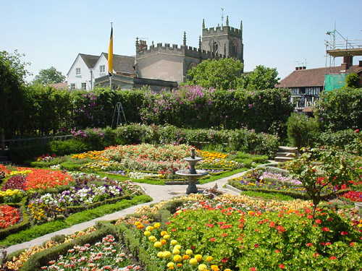
Gardens

Slide 11
Monarchs
Queen Elizabeth I – like the theatre
James I – supporter of the arts, but not a strong monarch

Slide 12
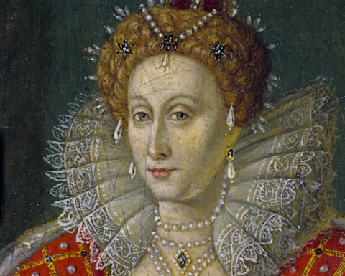
Queen Elizabeth I

Slide 13
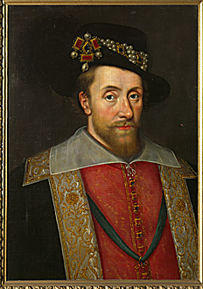
James I

Slide 14
London
Walled city of approximately 200,000
No sewers
Plague goes through 2x during Shakepeare’s lifetime
Very poor medical care
Poor areas and wealthy areas

Slide 15
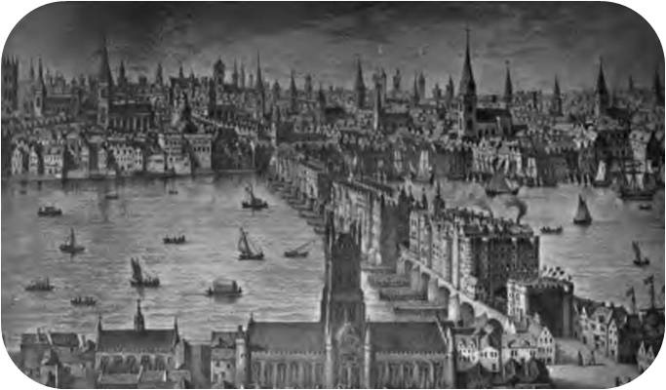
London during Shakespeare’s time

Slide 16
Career
Starts out as a “holder of the horses”
Eventually becomes an actor – fairly well known, but not great
Joins Lord Chamberlain’s Men (Lord Chamberlain is the patron)
Becomes the King’s Men when James I takes the throne
Becomes a playwrite (writes plays for his company but does not own them)

Slide 17
Writes approximately 37 plays in total
Writes numerous sonnets and poems (Venus and Adonis was his first published work)

Slide 18
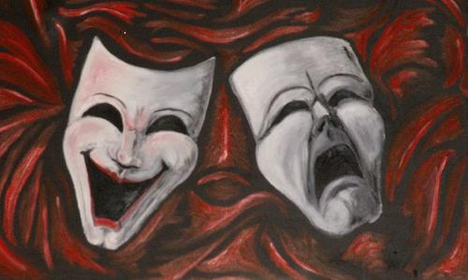
His plays
Histories: based loosely on history
Tragedies: the protagonist dies
Comedies: life works out well for the protagonist – usually ends with a wedding

Slide 19
Did Shakespeare create his own plots
NO!
He retold stories that already existed – this was not considered plagiarism in Shakespeare’s day

Slide 20
The Theatre
3 stories
Octagonal in shape
Based on the layout of a Medieval Inn
Stage was uncovered and jutted out into the pit
Musicians and the wealthy sat above the stage
Inner stage, trap door, curtain, balcony

Slide 21
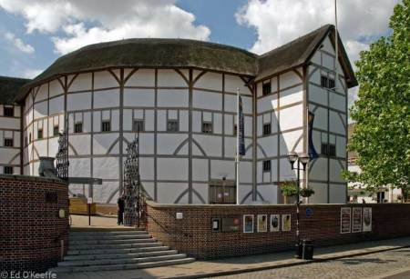
Modern day Globe

Slide 22
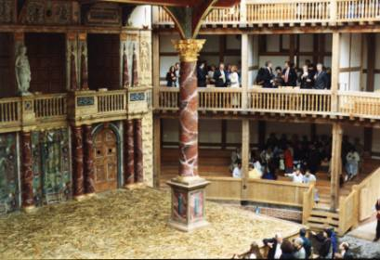
Stage

Slide 23
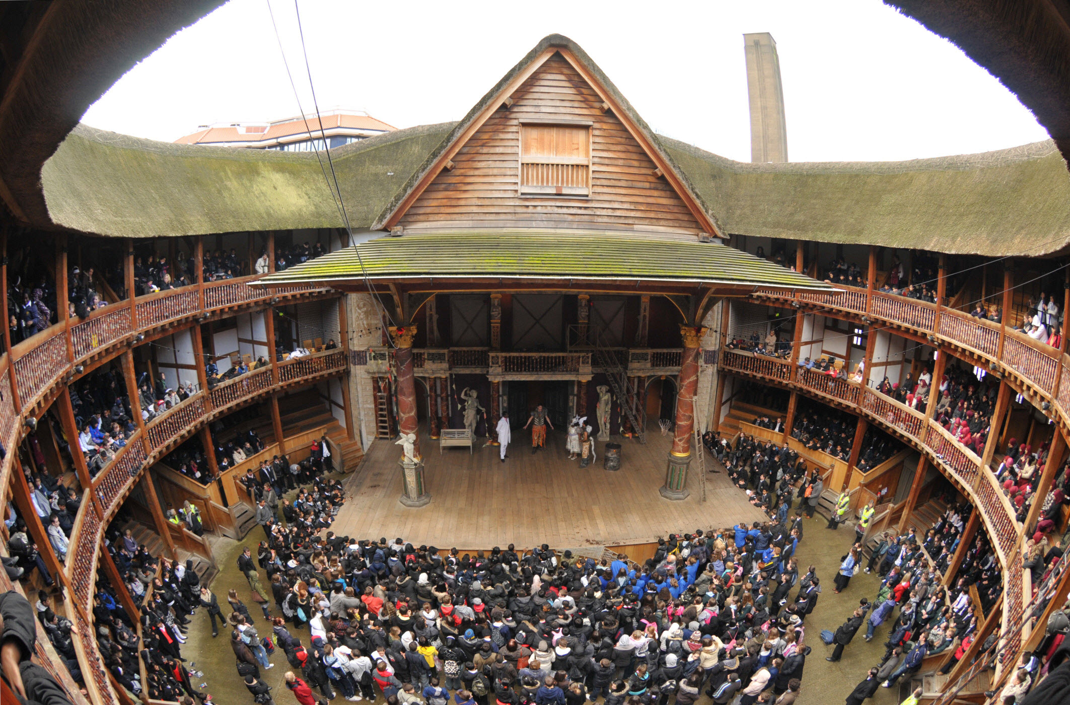
Bird’s eye view (not the Globe)

Slide 24
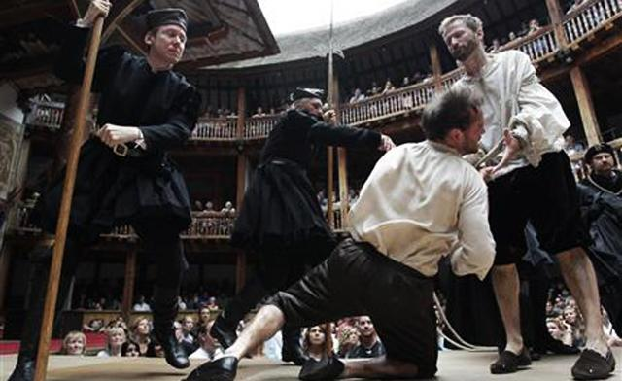
Actors
All men
Women’s roles were played by boys who had not yet reached puberty

Slide 25
Performances
Performances occurred in the middle of the day on sunny days
A play usually lasted 2 weeks in duration
A black flag meant a tragedy
A white flag meant a comedy
A red flag meant a history

Slide 26
Publication
Plays were owned by the company
Only published when the company needed money
Many illegal copies

Slide 27
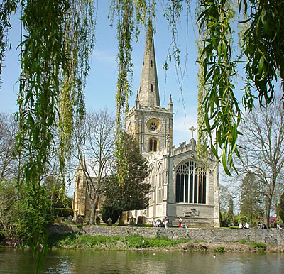
Holy Trinity Church

Slide 28
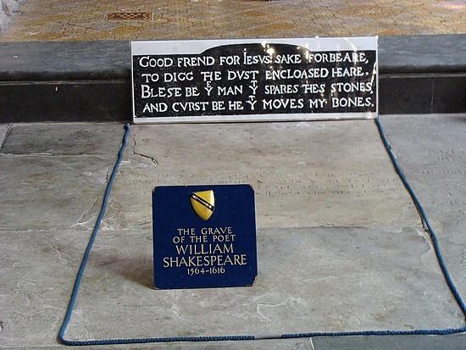
Shakespeare’s Grave

Slide 29
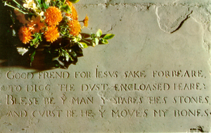
Inscription

